Slide 1
What’s new with SQL Server
A catchup guide for developers (2014-20179)

Slide 2

About me
Bill Fellows
Owner Sterling Data Consulting (happy to take your money)
SQL Server 7 - current
Microsoft Data Platform MVP
Loves: SSIS, TSQL, Python, problem solving
bill.fellows@sterlingdataconsulting.com
@billinkc
816.200.7682
Not me

Slide 3

About you
Developer
A busy developer
Interested in how and when to use a feature

Slide 4
Agenda
New SQL Server engine features for developers
2014
2016
2017
2019?

Slide 5
2014
ColumnstoreIndex
Memory Optimized Objects
Select Into
2014
2016
2017
2019

Slide 6
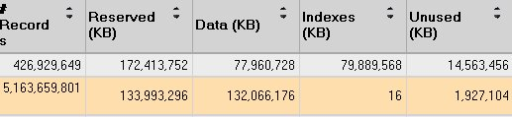
Clustered Columnstore Index
Updateable
Compressable for low cardinality
1M rows or more
Column elimination
Background custodial processes
2014
2016
2017
2019
Notes:
Niko really likes Columnstore indexes http://www.nikoport.com/columnstore/
Easy primer https://blogs.sentryone.com/melissacoates/overview-columnstore-indexes-sql-server/

Slide 7
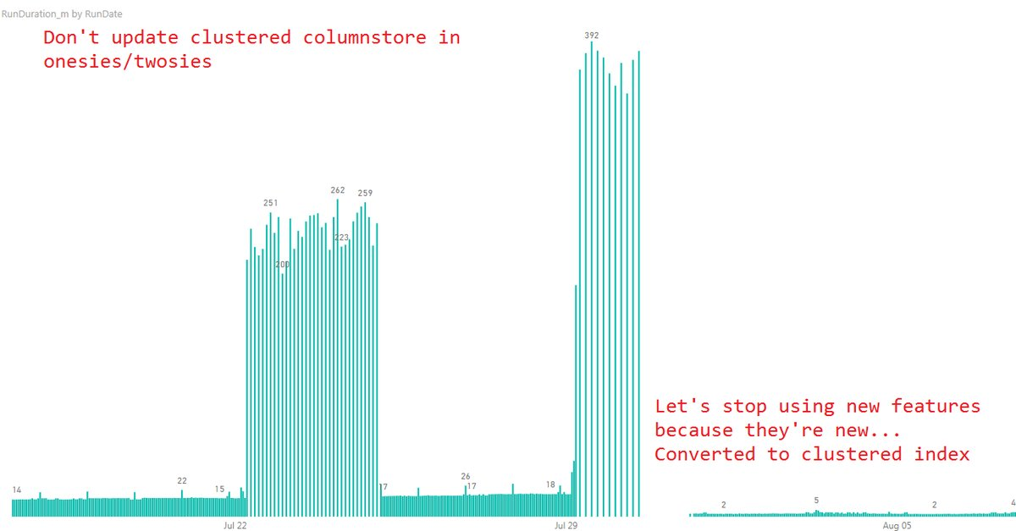
2014
2016
2017
2019

Slide 8
In-Memory OLTP
Tables Table Variables Procedures
ACID compliant; different implementation
Durable vs non-durable
Use case: staging tables for ETL
2014
2016
2017
2019
Notes:
https://docs.microsoft.com/en-us/sql/relational-databases/in-memory-oltp/in-memory-oltp-in-memory-optimization?view=sql-server-2014
https://docs.microsoft.com/en-us/sql/relational-databases/in-memory-oltp/memory-optimized-tables?view=sql-server-2014
https://sqljudo.wordpress.com/2015/03/10/tsql-tue-64-tuning-ssis-with-in-memory-stage/

Slide 9
Select Into
Parallel insert now available with SELECT INTO
Why?
Speed
Why not?
Havoc on source control
2014
2016
2017
2019

Slide 10
2016
Always Encrypted
Create or Alter
Dynamic Data Masking
Drop if Exists
FormatMessage
JSON
R
SessionContext
String Split/Escape
Truncate partition
2014
2016
2017
2019

Slide 11
Always Encrypted
Finally, the DBA is defeated!
Always Encrypted provides a separation between those who own the data (and can view it) and those who manage the data (but should have no access)
Trivial to implement
Database | Application
Add key | Add property to connection string
Run encryption wizard | Parameterize queries
2014
2016
2017
2019
Notes:
Almost. Denver was more clever than me
Also, make sure the patient name is deterministic

Slide 12
Create or alter
Syntactic sugar
No longer have to have two different commands for changing objects
STORED PROCEDURES
FUNCTIONS
TRIGGERS
VIEWS
2014
2016
2017
2019

Slide 13
Dynamic data masking
Dynamic Data Masking is a lightweight feature that allows the obscuring of data without physically changing it.
Default
Email
Partial
Random
Super important note from Books Online
Dynamic Data Masking should not be used as an isolated measure to fully secure sensitive data from users running ad-hoc queries on the database. It is appropriate for preventing accidental sensitive data exposure, but will not protect against malicious intent to infer the underlying data.
2014
2016
2017
2019
Notes:
https://docs.microsoft.com/en-us/sql/relational-databases/security/dynamic-data-masking?view=sql-server-2017

Slide 14

Drop if exists
More syntactic sugar!
Wider range of objects
Sorry about your permissions
AGGREGATE | ASSEMBLY
DATABASE | DEFAULT
FUNCTION | INDEX
PROCEDURE | ROLE
RULE | SCHEMA
SECURITY POLICY | SEQUENCE
SYNONYM | TABLE
TRIGGER | TYPE
USER | VIEW
2014
2016
2017
2019

Slide 15
FORMATMESSAGE
Now allows for a subset of C style formatters
Similar to RAISERROR but allows for further formatting
2014
2016
2017
2019
Notes:
https://docs.microsoft.com/en-us/sql/t-sql/functions/formatmessage-transact-sql?view=sql-server-2017

Slide 16

JSON
All the joy of XML in fewer characters.
{"CollectionName":
[
{"number":1,"type":"A","foo":null}
, {...}
]
}
ISJSON JSON_VALUE
JSON_QUERY JSON_MODIFY
OPENJSON
JSON, not Jason
2014
2016
2017
2019

Slide 17

R
External processing, all on local server.
Avoids leaky data
Requires service restart
2014
2016
2017
2019

Slide 18
Row Level Security
2016 introduced a new object, SECURITY POLICY.
Security policies allow you to block actions and force filtering by writing custom functions
2014
2016
2017
2019

Slide 19
SESSION_CONTEXT
Like CONTEXT_INFO, but better. Key-value pairs of text instead of a single bitmasked values
2014
2016
2017
2019
Notes:
https://docs.microsoft.com/en-us/sql/t-sql/functions/session-context-transact-sql?view=sql-server-2017
https://docs.microsoft.com/en-us/sql/relational-databases/system-stored-procedures/sp-set-session-context-transact-sql?view=sql-server-2017

Slide 20
STRING_SPLIT and STRING_ESCAPE
String splitting will shred a column into multiple rows
SELECT * FROM STRING_SPLIT('1,2,3,4,5', ',') AS Demo;
String escaping will replace invalid characters with their entity values. Applicable to JSON
SELECT STRING_ESCAPE('Hello tab' + CHAR(9)+'world', 'json');
What’s missing?
2014
2016
2017
2019
Notes:
https://docs.microsoft.com/en-us/sql/t-sql/functions/string-split-transact-sql?view=sql-server-2017
https://docs.microsoft.com/en-us/sql/t-sql/functions/string-escape-transact-sql?view=sql-server-2017

Slide 21
TRUNCATE
Truncate can now target a specific partition(s)
TRUNCATE TABLE dbo.PartitionDemo WITH (PARTITIONS (2, 4, 6 TO 8));
2014
2016
2017
2019
Notes:
https://docs.microsoft.com/en-us/sql/t-sql/statements/truncate-table-transact-sql?view=sql-server-2017

Slide 22
2017
CLR
COMPRESS/DECOMPRESS
Graph Processing
Linux
Python
SELECT INTO
STRING_AGG
2014
2016
2017
2019

Slide 23
CLR
Now runs on Linux
And we completely changed out how permissions worked
2014
2016
2017
2019
Notes:
No demo

Slide 24
COMPRESS DECOMPRESS
Now you can zip/unzip natively within TSQL using GZIP algorithm
2014
2016
2017
2019

Slide 25
Graph processing
Graph processing has nothing to do with visualizations
Everything to do with relationships
Nodes
Edges
2014
2016
2017
2019

Slide 26

Linux
SQL Server runs on Linux
2014
2016
2017
2019

Slide 27
Python
sys.sp_execute_external_script returns!
Rampant speculation, what other languages might we specify in v.Next?
2014
2016
2017
2019

Slide 28
SELECT INTO (again)
Specify target filegroup
2014
2016
2017
2019

Slide 29
STRING_AGG
Combines multiple rows of data using a delimter
Classic approach involves undocumented behavior from FOR XML PATH clause
2014
2016
2017
2019

Slide 30
2019
String or Binary Data Would be truncated
Inline Scalar UDFs
Java
2014
2016
2017
2019

Slide 31
String or Binary Data Would be truncated
Traceflag 460 (session or server level required)
BACKPORTED TO SQL SERVER 2017 CU12 AND 2016 SP2 CU TBD
https://blogs.msdn.microsoft.com/sql_server_team/string-or-binary-data-would-be-truncated-replacing-the-infamous-error-8152/
2014
2016
2017
2019

Slide 32
Inline Scalar UDFs
No longer a black box for performance
Maybe it can be inlined, maybe it can't.
https://blogs.msdn.microsoft.com/sqlserverstorageengine/2018/11/07/introducing-scalar-udf-inlining/
https://www.brentozar.com/archive/2018/11/sql-server-2019-faster-functions/
2014
2016
2017
2019

Slide 33

Java
sys.sp_execute_external_script yet again
2014
2016
2017
2019

Slide 34
2014
2016
2017
2019

Slide 35
Thank you
Visit the sponsors
Patch your servers
Notes:
https://github.com/billinkc/presentations/tree/master/WhatsNew

